Slide 1
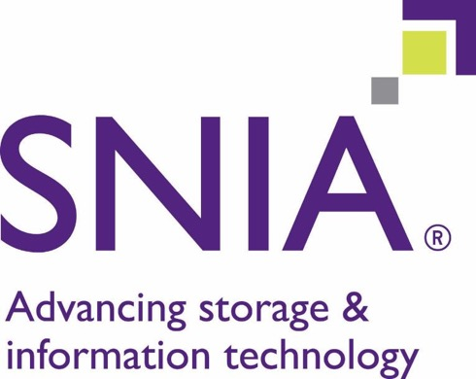

Slide 2
SNIA Connects SmartNICs and Storage
SmartNIC Summit
April 27, 2022

Slide 3
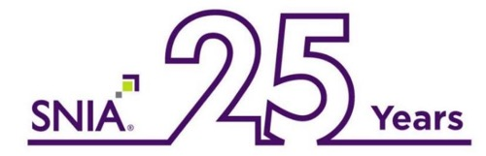
SNIA: Storage Networking Industry Association
It is the worldwide trusted authority for “all things storage”
Develops industry-leading architectures and standards
Delivers vendor-neutral educational content and events
The collaborative industry association for storage companies

Slide 4
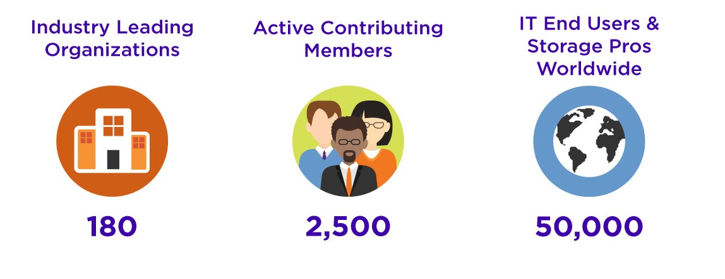
SNIA By The Numbers

Slide 5
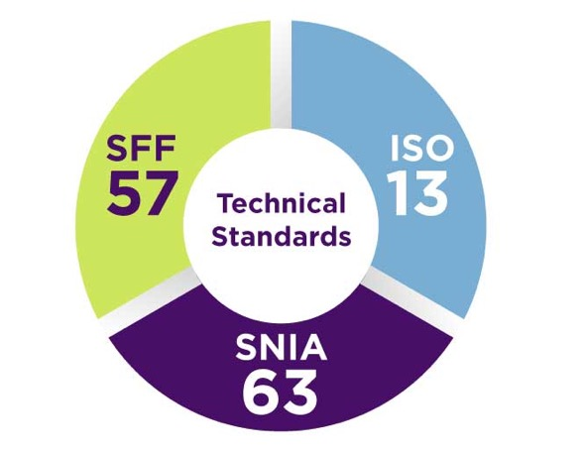
Current Storage Technologies in Focus
Blockchain Data and Storage
Cloud Data Management (CDMI™)
Computational Storage Architecture
DNA Storage
Green Storage
Key Value
LTFS
NVMe ®
NVMe-oF™
Scalable Storage Management
SIRF
Smart Data Accelerator Interface (SDXI)
Solid State Storage
xPU
Zoned Storage

Slide 6



The Bedrock of Storage Education
SNIA is a worldwide source for vendor-neutral Storage and Information Management Technologies
Searchable Educational Library
Technical White Papers and Industry Advisories
Webcasts, Videos, and Podcasts
SNIA Blogs and Articles
Industry-recognized Storage/IT Dictionary
Notes:
Provide independent technology education from basics
to advanced techniques
Enable IT professionals to keep abreast

Slide 7
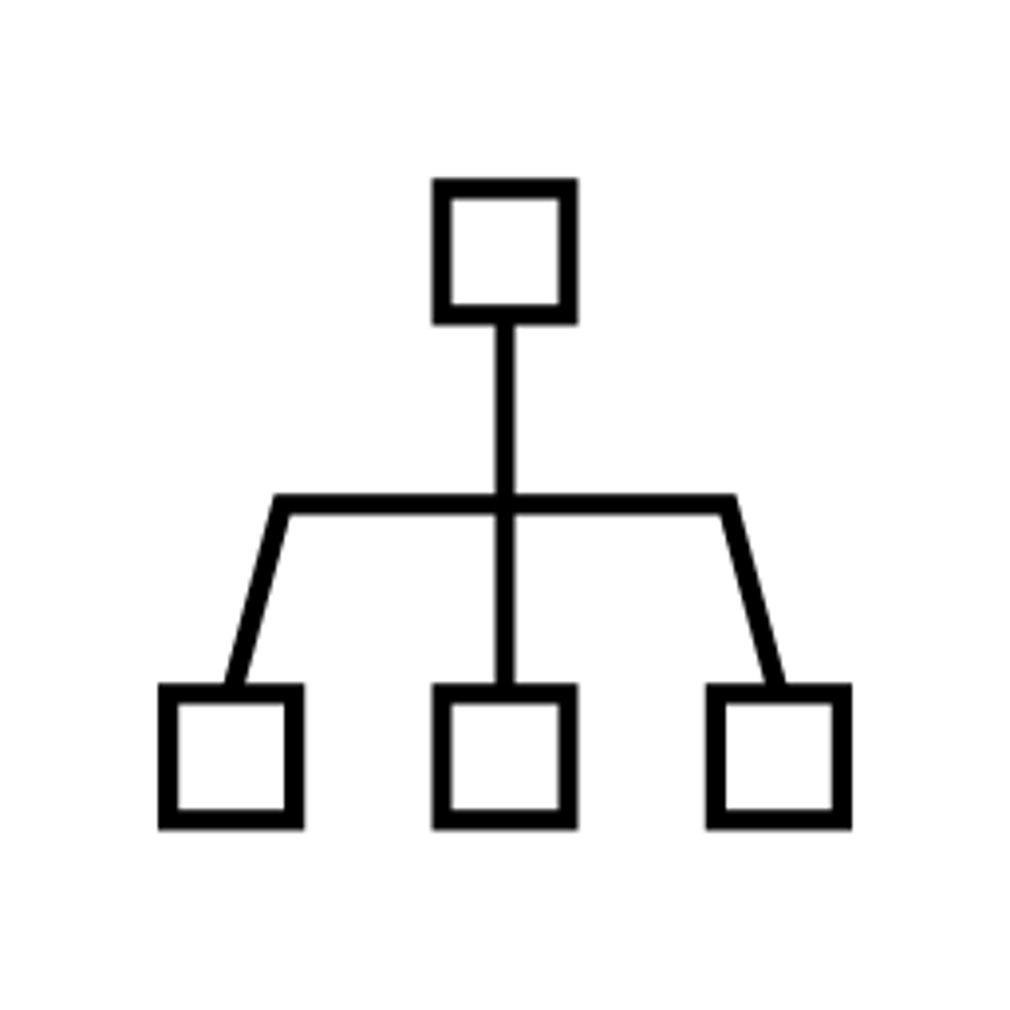
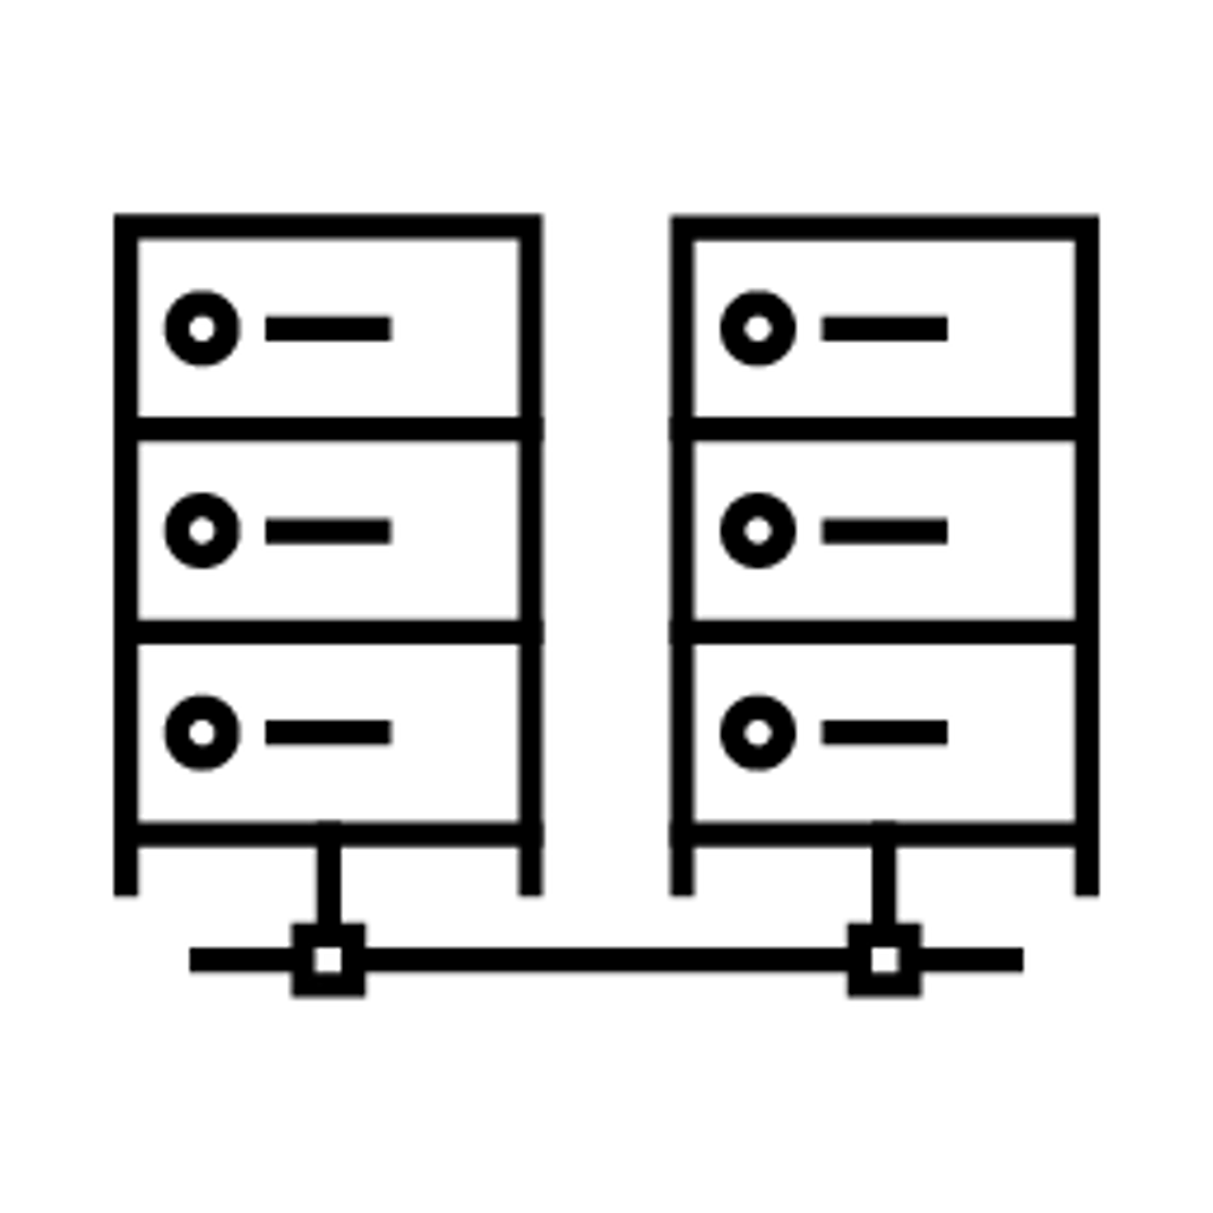




Five Ways SmartNICs Advance Storage
Networking
Software-Defined Storage / HCI
Virtualization / Cloud
Security
Computational Storage

Slide 8
SNIA Work on xPUs
SNIA xPU Task Force
Upcoming 3-Part Webcast Series
SmartNICs to xPUs: Why is the Use of Accelerators Accelerating?
xPU Accelerator Offload Functions
Deployment and Solutions Deep Dive
Register Here

Slide 9




Engage with SNIA Visit: SNIA.ORG
SNIA International
SNIA Blogs
Discover SNIA
SNIA Brazil
SNIA EMEA
SNIA India
SNIA Japan
SNIA on Storage
Cloud Storage
Network Storage
Compute, Memory & Storage
Storage Management
Standards
Education
Technology Focus Areas
News & Events
Resources
Membership
Notes:
@SNIA, @SNIACloud, @SNIACMSI, @SNIANSF, @SNIASDC, @SNIASecurity, @SNIA_India, @SNIA_EMEA
LinkedIn.com/company/SNIA
SNIAVideo/YouTube
Facebook.com/SNIA

Slide 10
Thank You

Slide 11
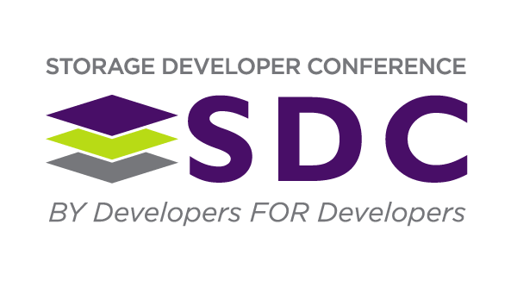
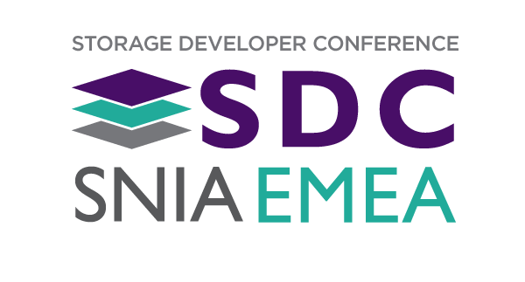
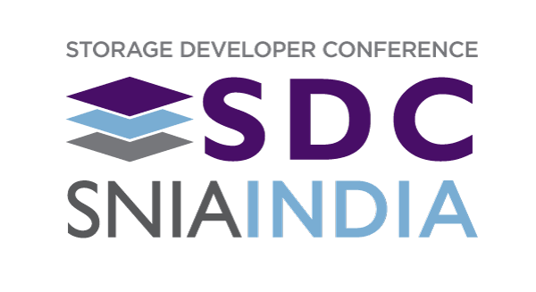
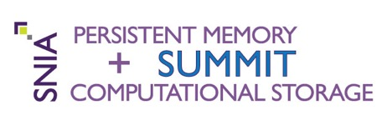

SNIA Hosted Global Events

